Slide 1
Building a Simple Text Classifier
Explore ML

Slide 2
Text Classification
Positive 10
Positive 7
Negative 10
Negative 5
That was the best movie ever!
I would rate it 7 out of 10
That was the worst movie ever!
Everyone but me liked the movie
?
2
It was ok
Positive
Negative
Notes:
Data is from the Large Movie Review Dataset v1.0 task from Mass et al.
The dataset consists of IMDB movie reviews labeled by sentiment from 1 to 10.
The task is to label the reviews as negative or positive.
Rather than train a model from scratch, we're going to reuse a model built for text classification. This allows you to focus on this specific task rather than spending the effort to recreate a high-quality text classification model.

Slide 3

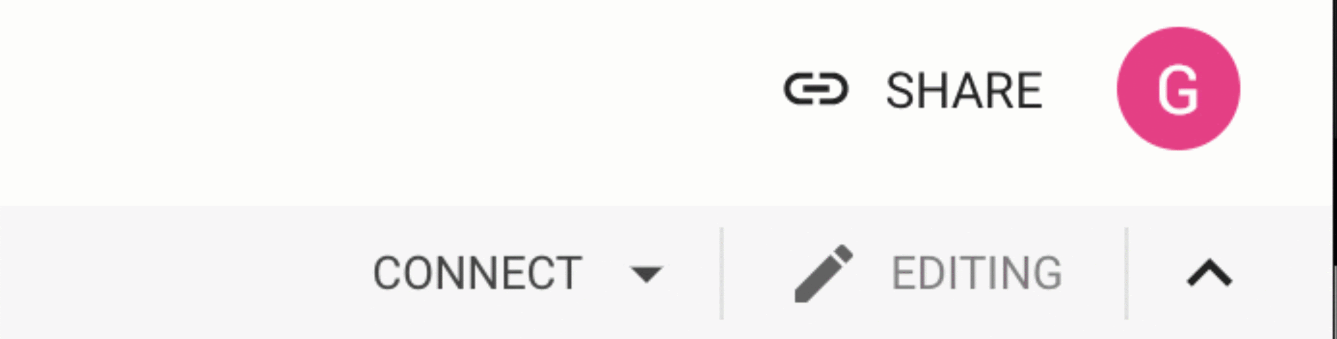
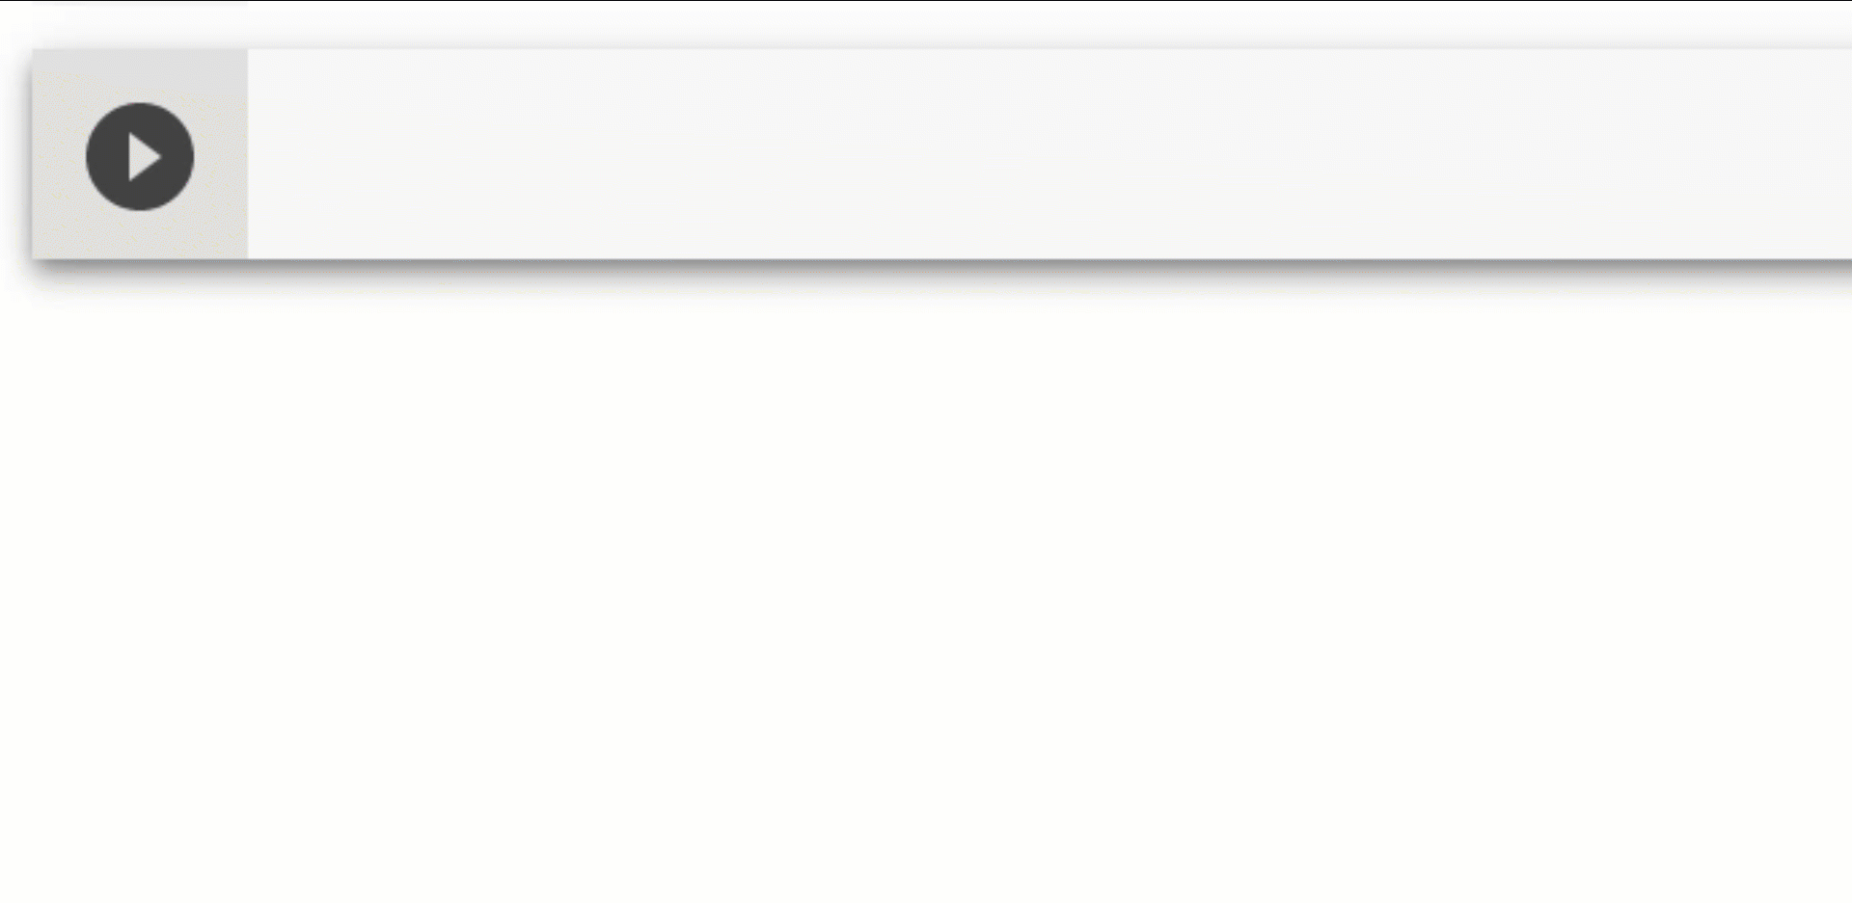
Text Classification Coding Activity
https://www.tensorflow.org/hub/tutorials/text_classification_with_tf_hub
Open the exercise in Colab
Sign in with your Google account
Activate the Runtime
Run code
Notes:
Let’s jump into the code!
Go to the exercise notebook
Open the exercise in Colab, a browser based notebook for running code in the cloud without needing to setup your computer.
Sign into your Google account (if it is their own account they can save the notebook in Drive to refer to later)
Activate the cloud-based runtime so you can run code in the cloud rather than setting up your machine
Run the code in a cell by clicking on the play/triangle button.

Slide 4
STOP
Do not present the following slides as a lecture.
They are for questions or a debrief after the activity.
Let learners work through the activity in pairs.

Slide 5
Import all libraries
# Install TF-Hub.
!pip install tensorflow-hub
!pip install seaborn
import tensorflow as tf
from tensorflow import keras
import numpy as np
import matplotlib.pyplot as plt
import os
import pandas as pd
import re
import seaborn as sns
Notes:
TF-Hub, a library for reusing machine learning models. By reusing a model, it's possible to train a model with a smaller dataset, improve generalization, and speed up training. Applying the learnings from a model to a new task is known as transfer learning.

Slide 6
Getting started with Data (1 of 3)
def load_directory_data(directory):
data = {}
data["sentence"] = []
data["sentiment"] = []
for file_path in os.listdir(directory):
with tf.gfile.GFile(os.path.join(directory, file_path), "r") as f:
data["sentence"].append(f.read())
data["sentiment"].append(re.match("\d+_(\d+)\.txt", file_path)
.group(1))
return pd.DataFrame.from_dict(data)
Notes:
First we will need to process the raw data and structure it in a way that is useful for us to explore the data as well as train a model.

Slide 7
Getting started with Data (2 of 3)
def load_dataset(directory):
pos_df = load_directory_data(os.path.join(directory, "pos"))
neg_df = load_directory_data(os.path.join(directory, "neg"))
pos_df["polarity"] = 1
neg_df["polarity"] = 0
return pd.concat([pos_df, neg_df]).sample(frac=1)
.reset_index(drop=True)

Slide 8
Getting started with Data
def download_and_load_datasets(force_download=False):
dataset = tf.keras.utils.get_file(
fname="aclImdb.tar.gz",
origin="FILE URL",
extract=True)
train_df = load_dataset(os.path.join(os.path.dirname(dataset),
"aclImdb", "train"))
test_df = load_dataset(os.path.join(os.path.dirname(dataset),
"aclImdb", "test"))
return train_df, test_df
Notes:
This code loading the files from the database and processing it.
What do you see when you run this?

Slide 9
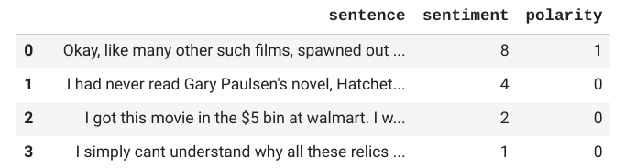

Exploring the Data
Notes:
Take a look at some of the reviews, what do you think the purpose is of ‘sentiment’ and ‘polarity’?
Sentiment is the strength of the emotion. For example furious vs annoyed or happy vs elated.
Polarity indicates whether the text is positive (1) or negative (0).

Slide 10
Input Functions
train_input_fn = tf.estimator.inputs.pandas_input_fn(
train_df, train_df["polarity"], num_epochs=None, shuffle=True)
predict_train_input_fn = tf.estimator.inputs.pandas_input_fn(
train_df, train_df["polarity"], shuffle=False)
predict_test_input_fn = tf.estimator.inputs.pandas_input_fn(
test_df, test_df["polarity"], shuffle=False)
Notes:
TensorFlow Estimators provides helper input functions to prepare the data as an input to train and test a model.

Slide 11
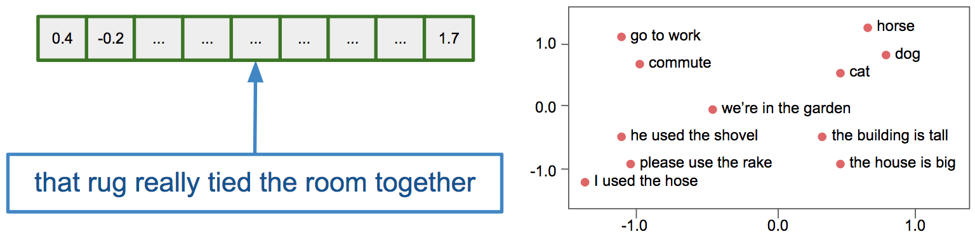
Feature Columns
embedded_text_feature_column = hub.text_embedding_column(
key="sentence",
module_spec="https://tfhub.dev/google/nnlm-en-dim128/1")
Notes:
We're using a prebuilt embedding which maps from text to 128-dimensional embedding vectors.
An embedding is representation of the data making it possible to visualize and calculate the distance from one data point to another.
In the diagram below an example sentence is transformed into a 1 dimensional (1D) vector. Once sentences are in this format, they can be plotted against other sentences to measure similarity, grammar, spelling, or in our case polarity and sentiment.
If learners would like to explore this concept further they could go to the Embedding Projector or Machine Learning Crash Course Embedding module
Image from Google https://developers.googleblog.com/2018/04/text-embedding-models-contain-bias.html

Slide 12
Estimator
estimator = tf.estimator.DNNClassifier(
hidden_units=[500, 100],
feature_columns=[embedded_text_feature_column],
n_classes=2,
optimizer=tf.train.AdagradOptimizer(learning_rate=0.003))
estimator.train(input_fn=train_input_fn, steps=1000);
Notes:
TensorFlow provides pre-made estimators to simplify the process of machine learning. It's possible to program the entire graph and flow of your program. Unless you are doing novel research you can usually get high performance out of a pre-made estimator.
It provides some parameters for you to experiment with but it handles the rest for you.
hidden_units define the size of the network in each layer. 500 units in the first and 100 in the second.
n_classes refers to the number of output classes in our case we have positive and negative.
During training the estimator is going to try various weights and bias values for the network in an effort to try and find the combination that minimizes loss (the difference between the prediction and the actual value).
The learning rate defines how small a step it is going to take between the values it tries.
The number of steps define how many attempts it will make at finding the optimal value.
Suppose I was attempting to guess a number you were thinking of and all you could do was provide feedback whether I was getting closer or further.
I could try and find your number by skipping by 5s (Is it 5, is it 10?). This is akin to the learning rate.
I could try this 10 times and see if I'm making progress. This is the number of steps I am taking.
If you chose a really big number this could take a long time. In ML the difference between ideal parameters may be minute which is why you often choose a small learning rate to minimize the chance of skipping it.
You will need to weigh the tradeoffs between speed and accuracy and needs/cost of your project since you can't have both.

Slide 13
Feature Columns
train_eval_result = estimator.evaluate(input_fn=predict_train_input_fn)
test_eval_result = estimator.evaluate(input_fn=predict_test_input_fn)
print("Training set accuracy: {accuracy}".format(**train_eval_result))
print("Test set accuracy: {accuracy}".format(**test_eval_result))
Training set accuracy: 0.8078399896621704
Test set accuracy: 0.7967600226402283
Notes:
Your results may differ. What do you think about these results?
The accuracy results you are willing to tolerate will depend on your goals.
Can you think of situations where you would be willing to settle for 80% accuracy? Or being wrong 1 in 5 times?
The larger the difference between the training set and the test set the less useful the model is because it is said to be overfit to the training data.
It's always possible to improve results:
More data / training examples
Changing estimator parameters
Trying different models / approaches / research
If time permits, allow learners time to go back and refine the estimator values (slide 11).

Slide 14
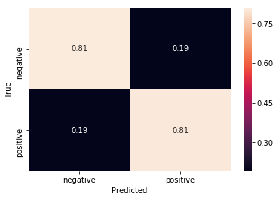
Confusion Matrix
TN
FP
Correct Predictions
Accuracy =
Total Predictions
TP + TN
TP + TN + FP + FN
FN
TP
Notes:
We can visually check the confusion matrix to understand the distribution of misclassifications.
A confusion matrix is a table that is often used to describe the performance of a classification model (or "classifier") on a set of test data for which the true values are known.
[Click to see labels added to image for further clarification]
The lighter the box, the more accurate the predictions. There are only two colors because there are only two output classes.
True Negative (TN) the movie review was negative and the model classified it correctly as negative.
False Negative (FN) - the movie review was positive and the model classified it incorrectly as positive.
True Positive (TP) - the movie review was positive and the model classified it correctly as positive.
False Positive (FP) - the movie review was negative and the model classified it incorrectly as positive.
Don't worry if you get them mixed up, even experts do it.
[Click to show equations for accuracy]
Accuracy measure the number of correct predictions. It should not be your own indicator of a well performing model. There are other evaluation metrics like precision which measures how many items which were predicted to be true actually are true. When you dig into it they can seem very similar but it is important to measure your model in various ways so you are aware of its limitations.

